Slide 1

Comparison of Food Choices of CITIES OF Cochin and Calicut

Slide 2
Understanding food choices help to improve business
Food choices of people differ from place to place
Investors should understand the food preference to get good turnout as well as the business to be profitable
Selection of location is also of prime importance for the business to be profitable

Slide 3
Data acquisition and cleaning
Postal code details of neighborhoods are collected
Coordinate details of neighborhoods are obtained using Python Geocoder package
Using Foursquare API, restaurant details are obtained

Slide 4
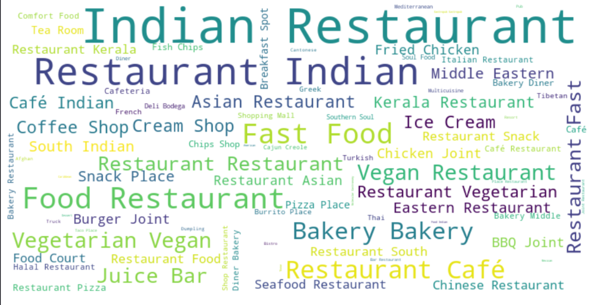
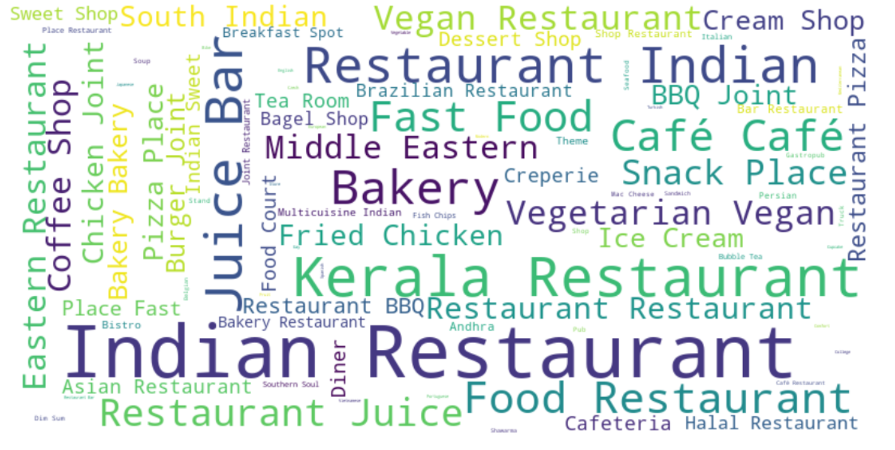
Exploratory data analysis
Restaurant types in Kochi
Restaurant types in Calicut

Slide 5
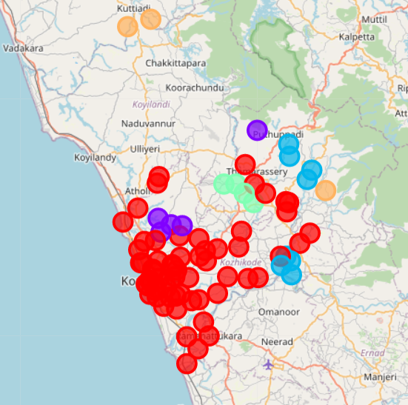
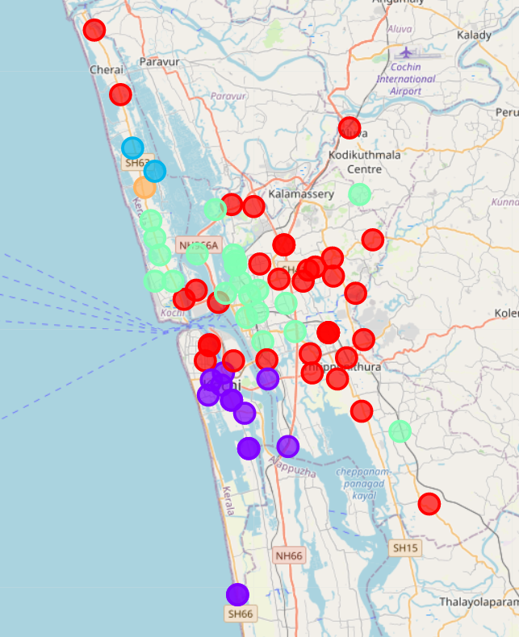
Clustering neighborhoods
Calicut Clusters
Kochi Clusters

Slide 6
Conclusion
The cluster size is more evenly distribution for Kochi in comparison with Calicut
Calicut prefers native recipes and middle eastern recipes mainly
Kochi also shows affinity to continental recipes
Number of unique restaurant types are more in Kochi in comparison with Calicut
Continental food varieties are more welcomed at Kochi

Slide 7
Future directions
The analysis at present is done in general and it can be done specifically on the restaurant of interest

